Slide 1
Reference Death Archive
Samuel Clark
openVA Team
The Ohio State University

Slide 2
Overview
Reference Death Archive
Verbal autopsy
Symptom-cause information
Reference Death Archive
Progress
Expectations for MITS Alliance Sites

Slide 3
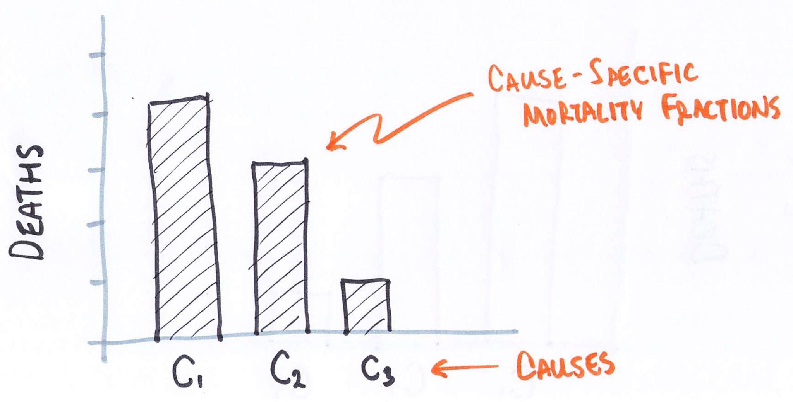
Burden of disease - BOD

Slide 4
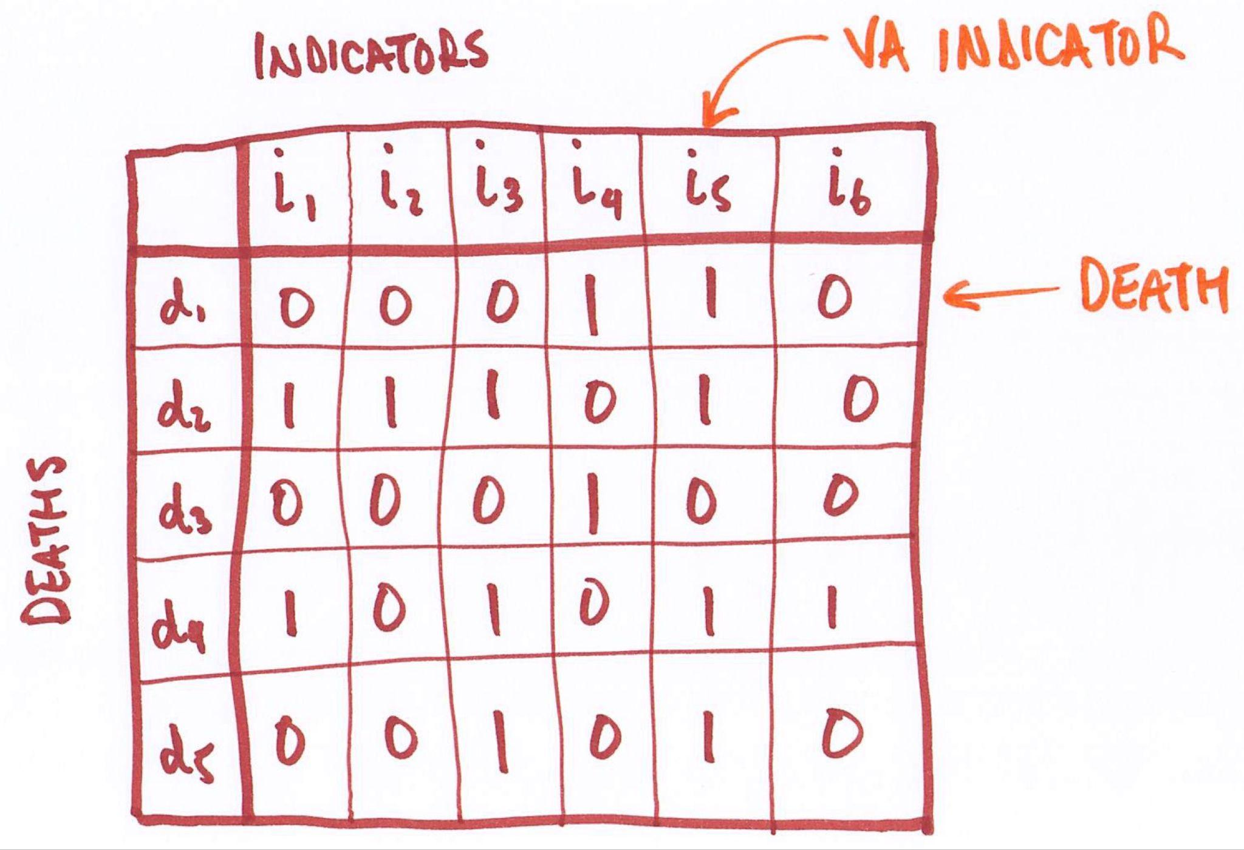
Verbal autopsy - VA
Interview with carers of decedent
Closed questions and free-form account (narrative)
Results in VA indicators
Feasible for at-scale, routine mortality surveillance
How do we move from VA indicators to BOD

Slide 5
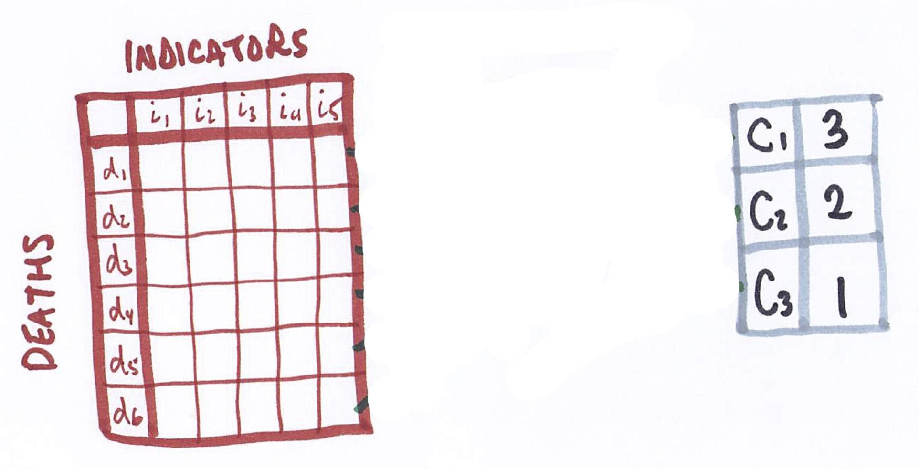
VA cause classification

Slide 6
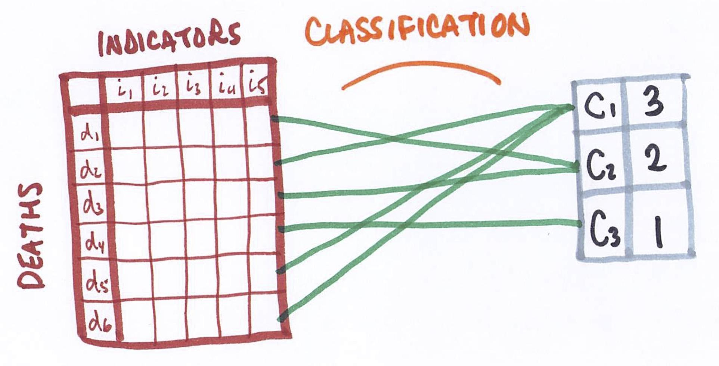
VA cause classification

Slide 7
Two approaches to VA classification
Physician-coded VA - PCVA
VA interviews read by 1-2 physicians
Consensus process
Identifies comparatively specific causes
Expensive, time-consuming, not replicable, and takes physicians from patients
Not feasible for at-scale mortality surveillance
Computer-coded VA - CCVA
Computer algorithm processes VAs to identify causes and cause-specific-mortality fractions
Identifies comparatively less specific causes
Cheap, fast, replicable, and no opportunity costs
Only feasible means of cause ascertainment for at-scale mortality surveillance where traditional cause ascertainment not possible (e.g. autopsy, medical record review, etc.)

Slide 8
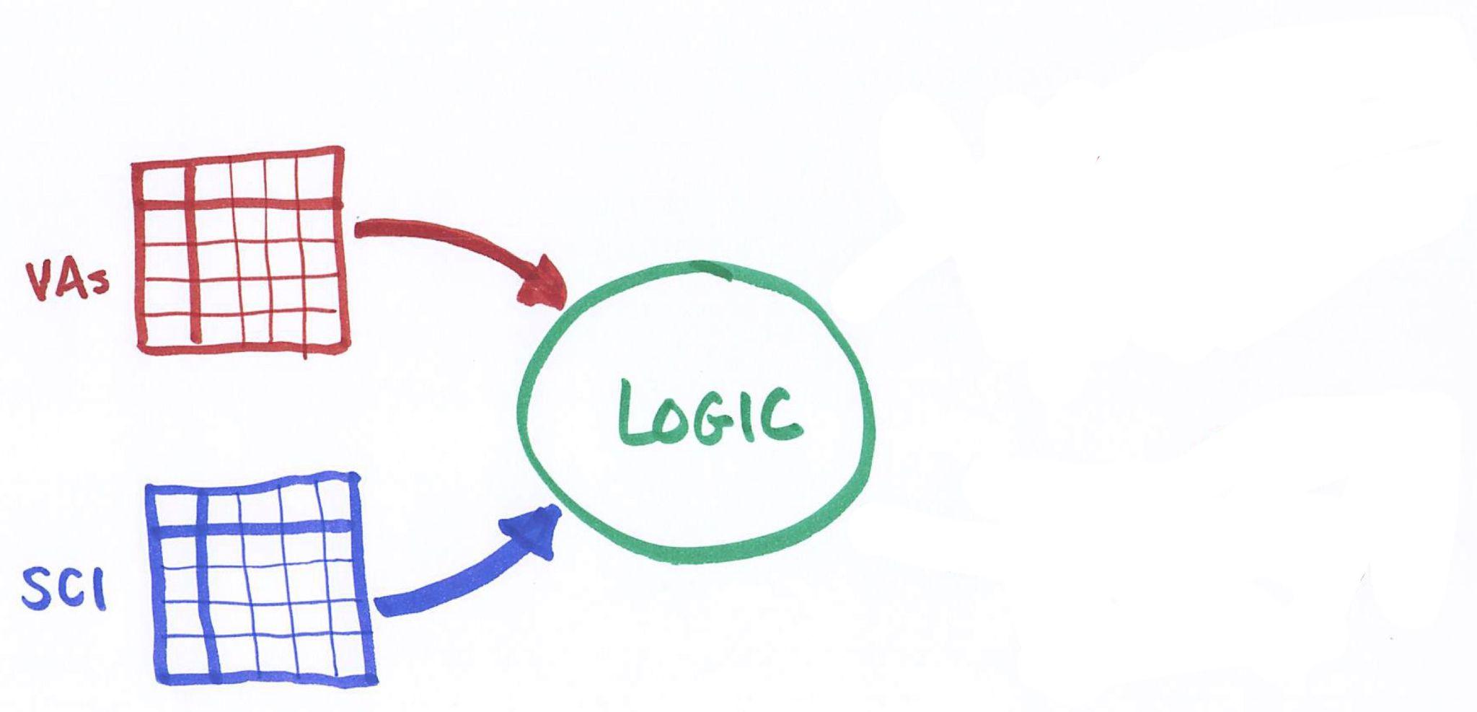
Computer-coded VA

Slide 9
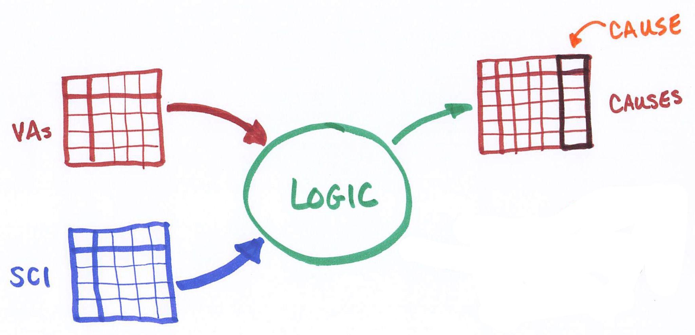
Computer-coded VA

Slide 10
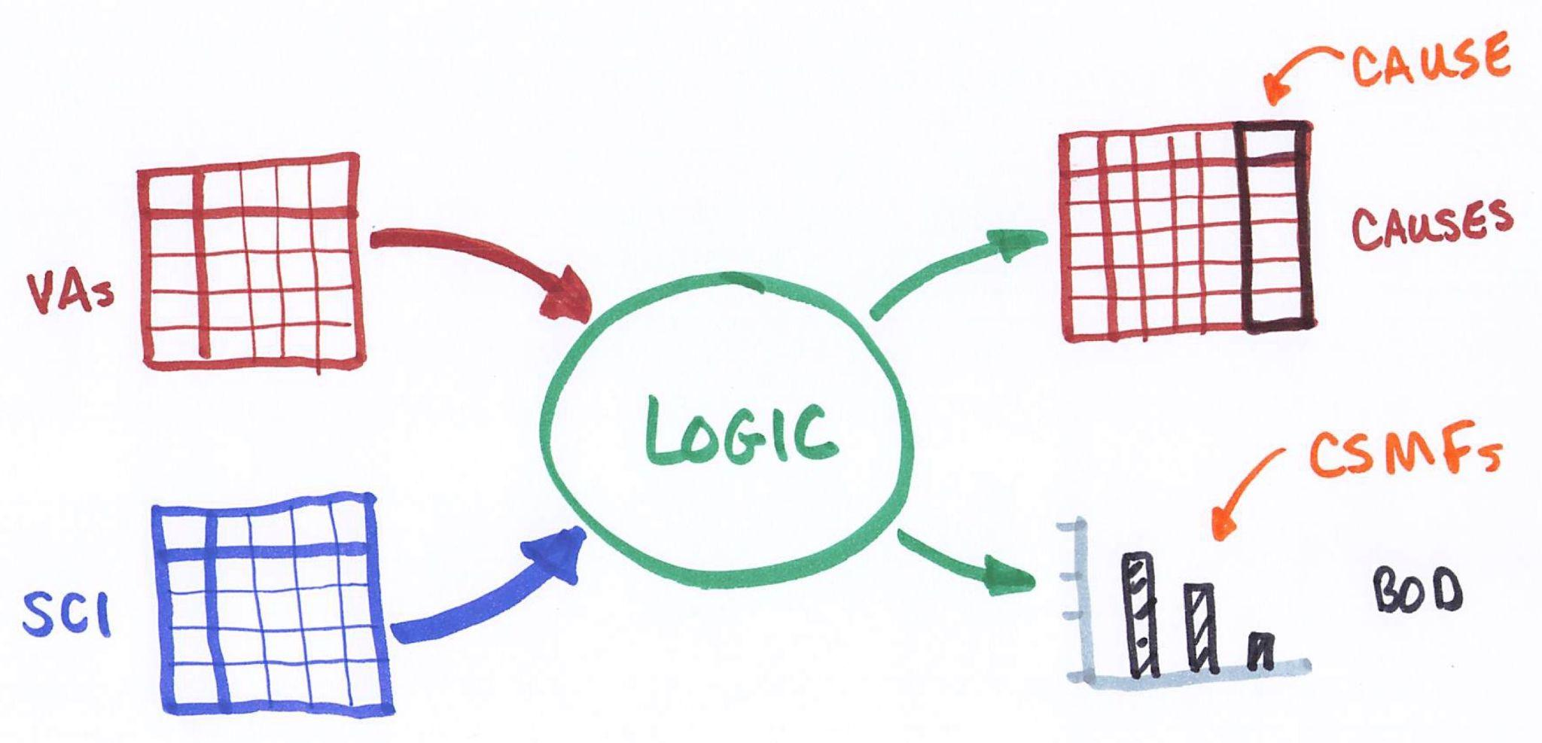
Computer-coded VA

Slide 11
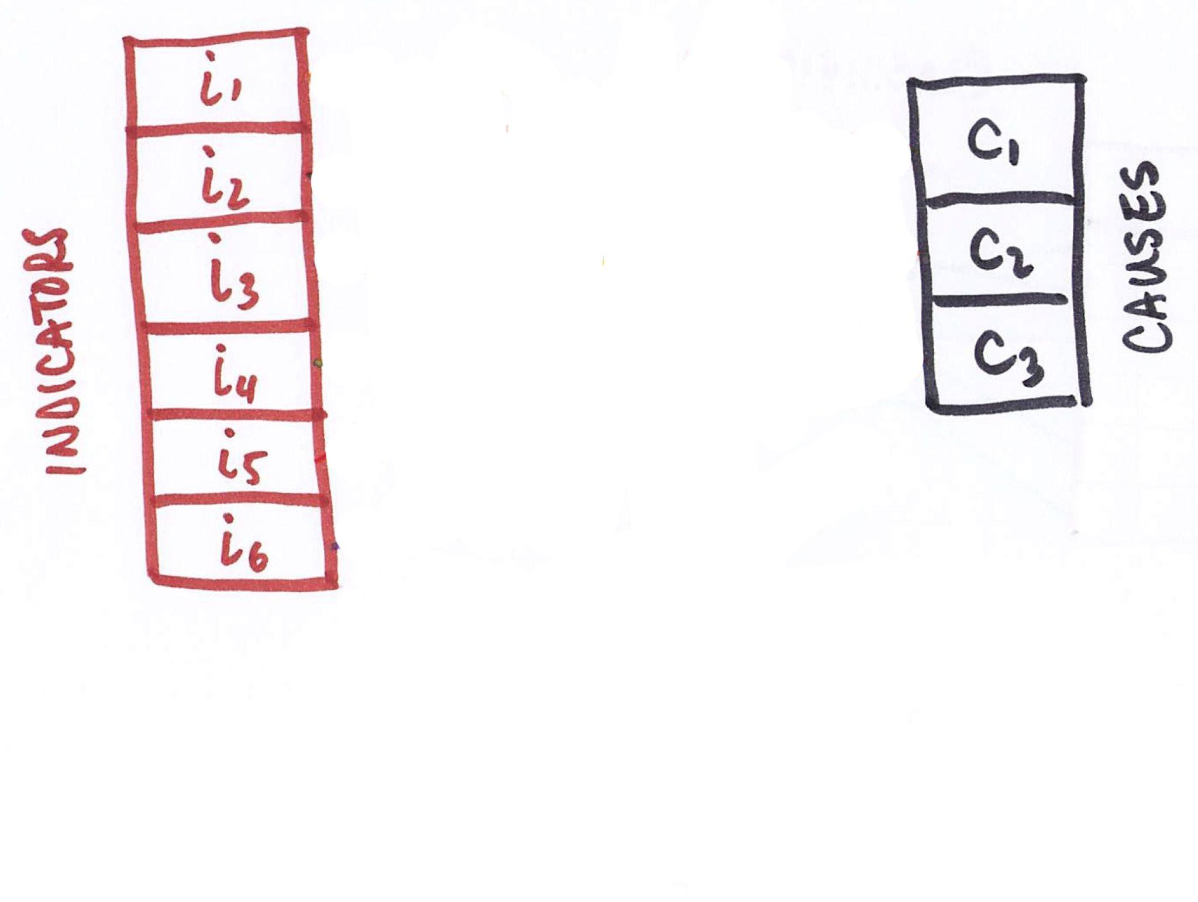
Symptom-cause information - SCI

Slide 12
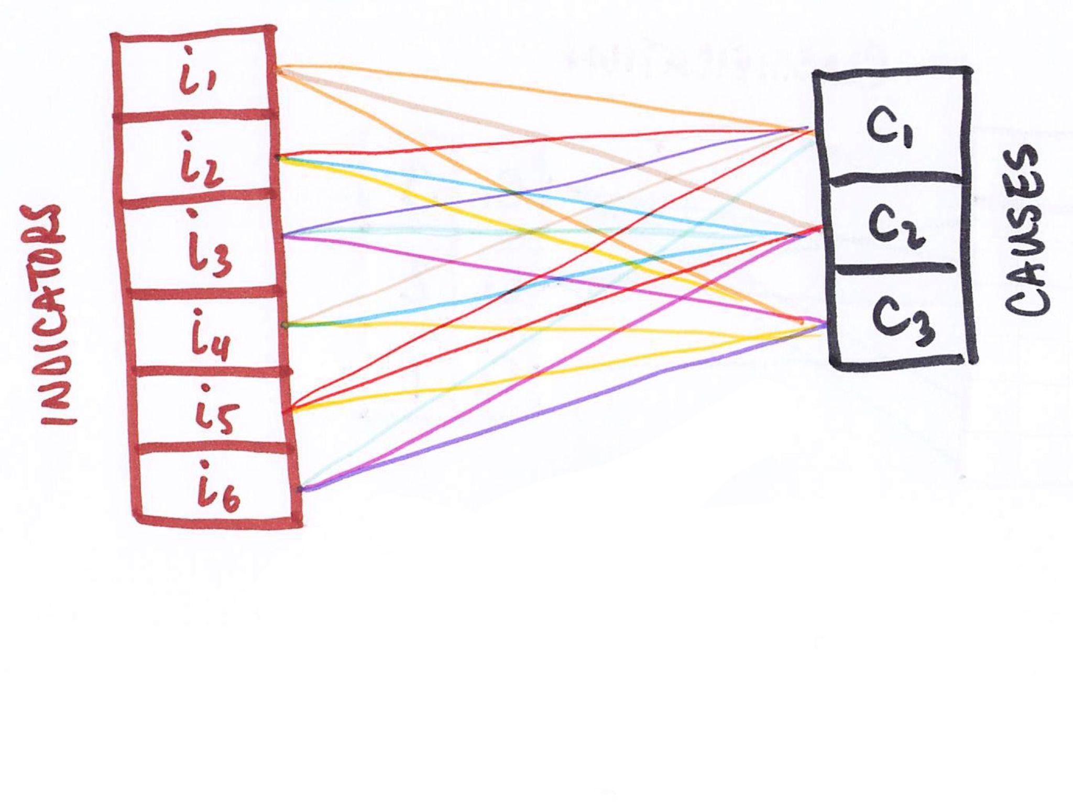
Symptom-cause information - SCI

Slide 13
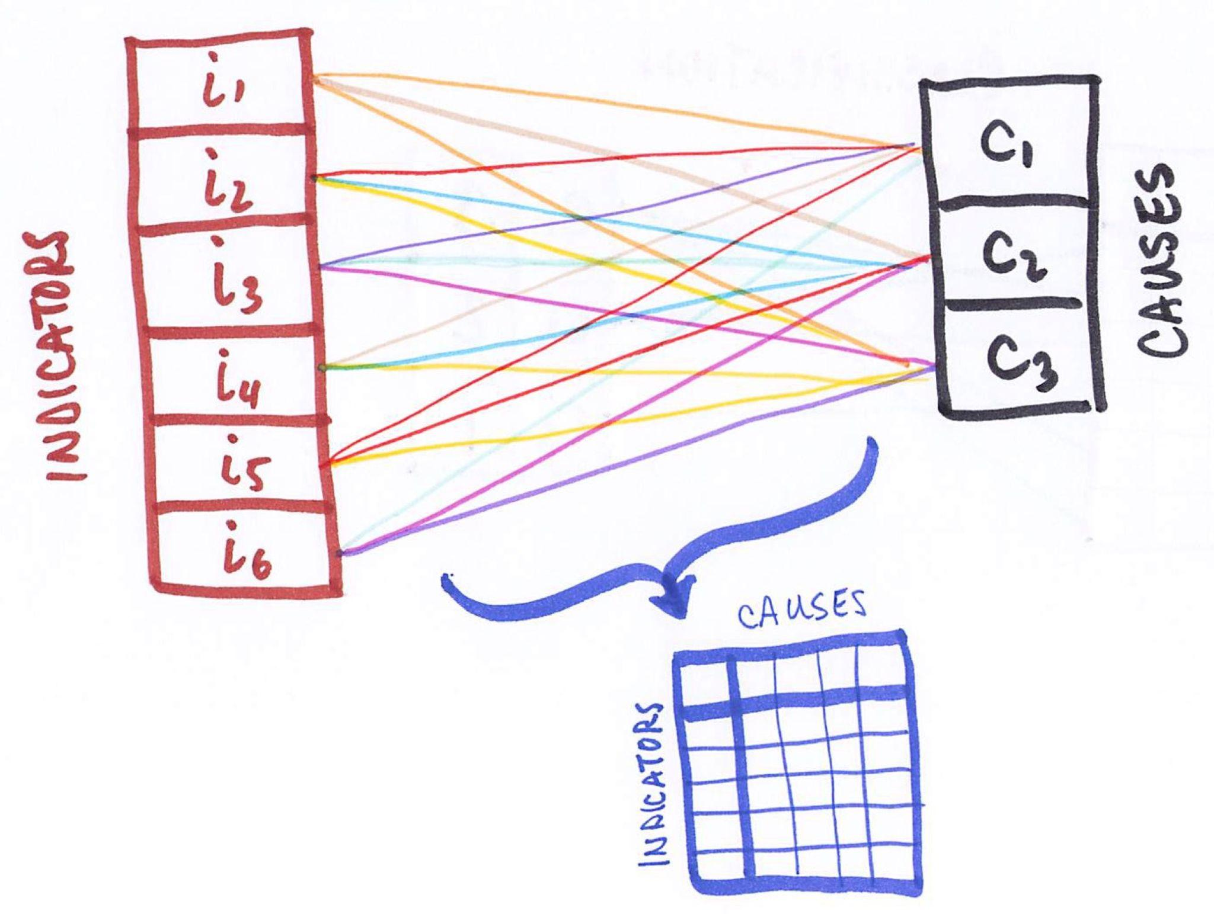
Symptom-cause information - SCI

Slide 14
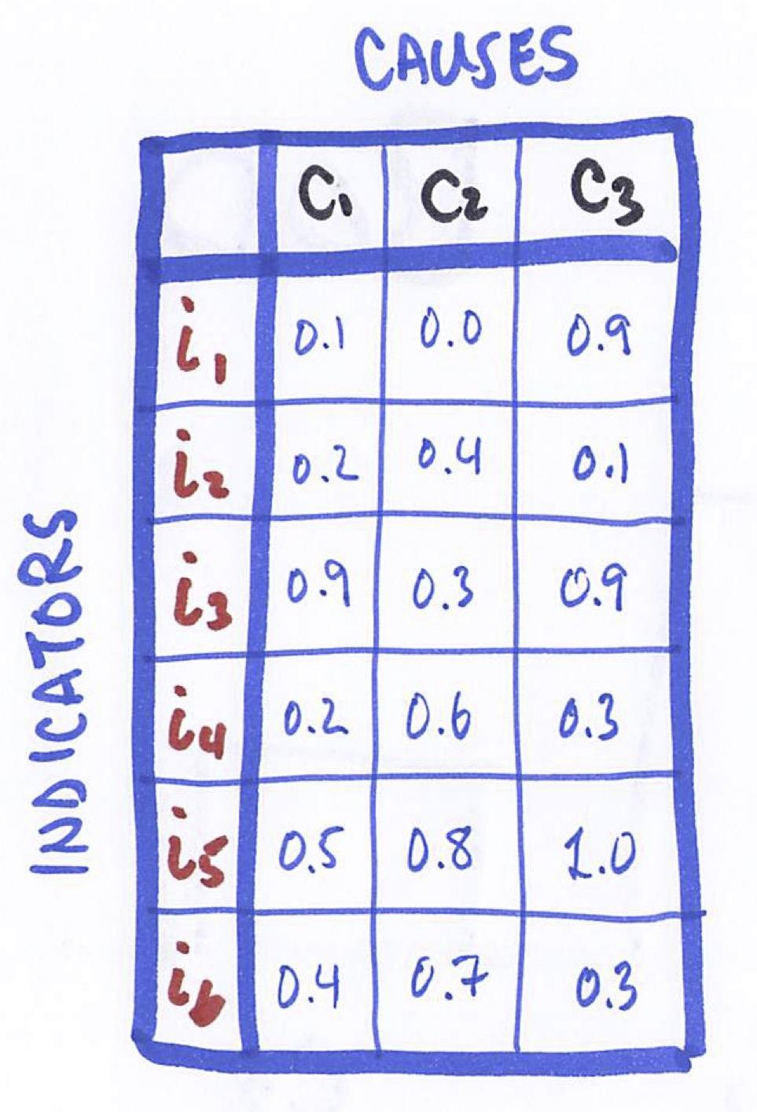
Symptom-cause information - SCI

Slide 15
Two approaches to creating SCI
Ask physicians directly
Consists of Pr(s|c)
Potentially applicable to wide variety of circumstances
Cheap and comparatively easy to do
Comparatively less information
Calculate from reference deaths
Reference deaths have VA and independently-ascertained reference cause
SCI can be calculated directly from reference deaths
Only applies to circumstances where/when reference deaths ocurred
Comparatively difficult to acquire enough reference deaths with adequate coverage of causes and circumstances
Comparatively (much) more information

Slide 16
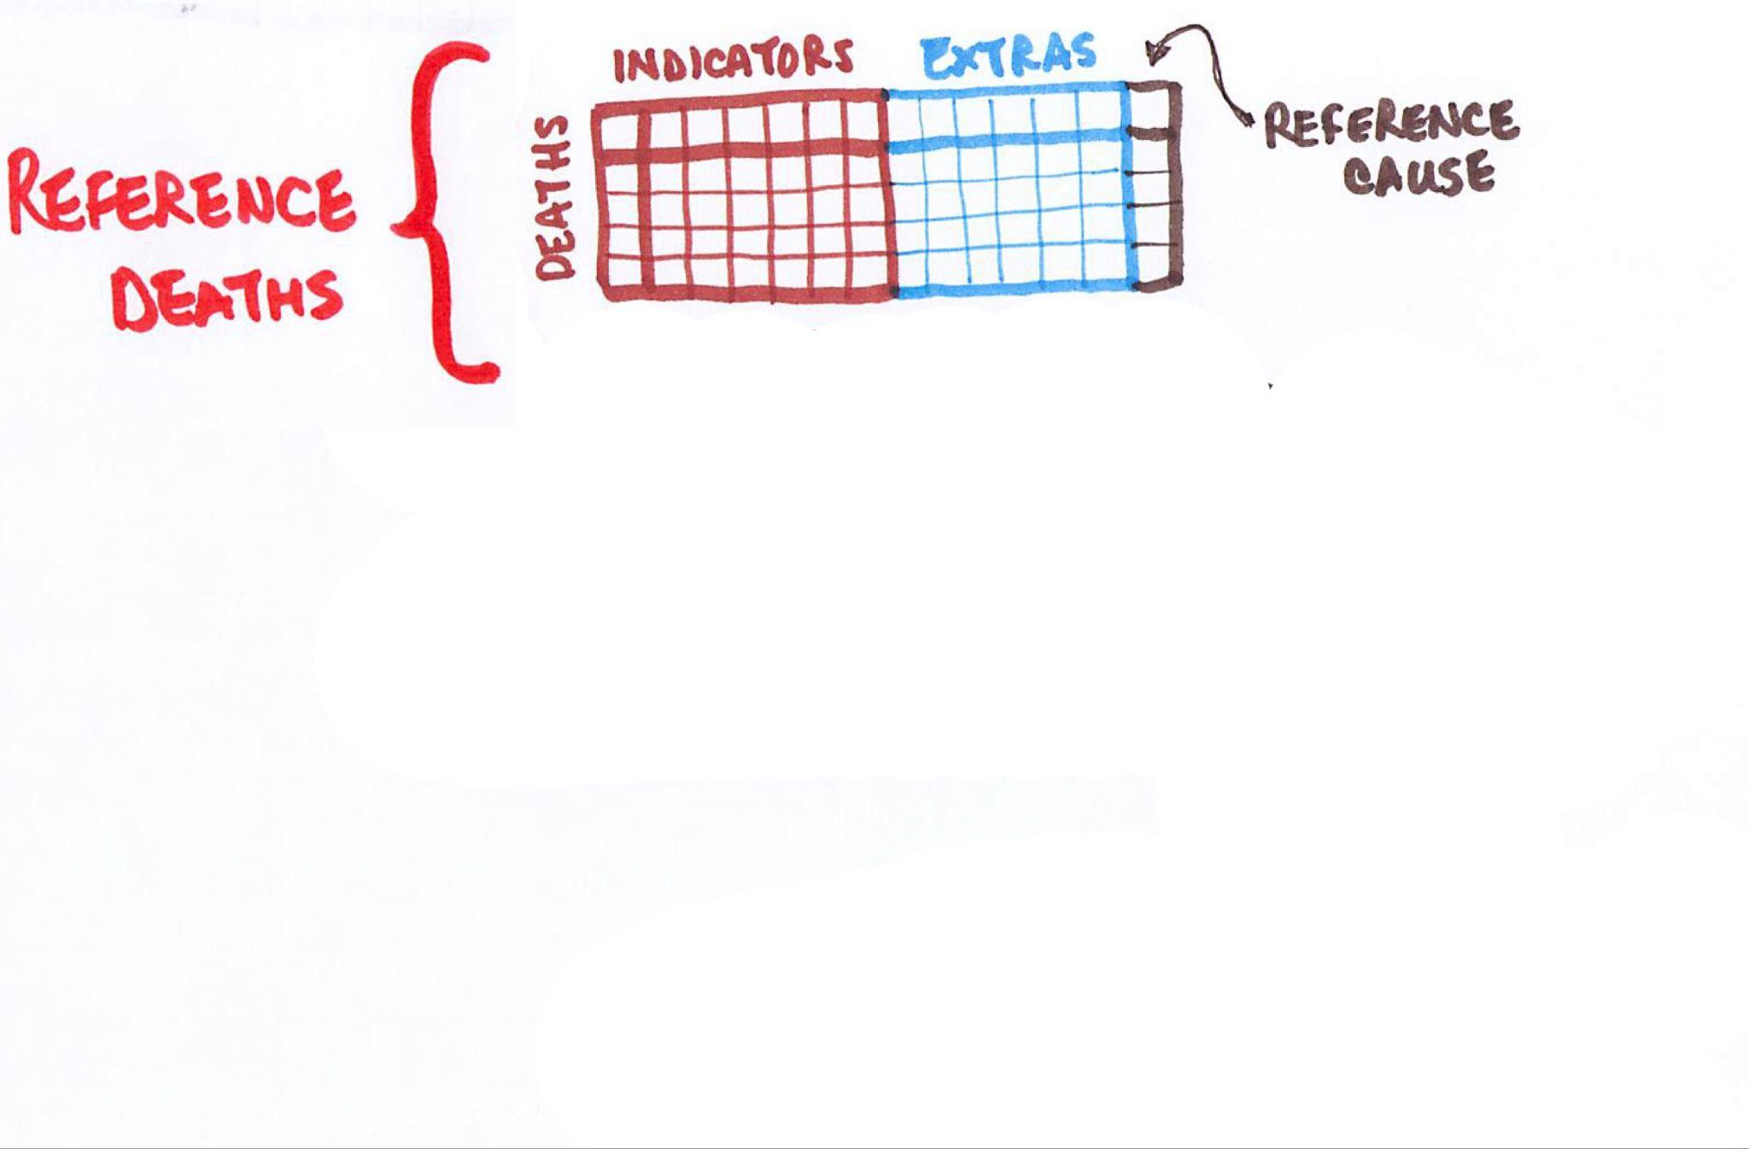
Reference death archive - RDA

Slide 17
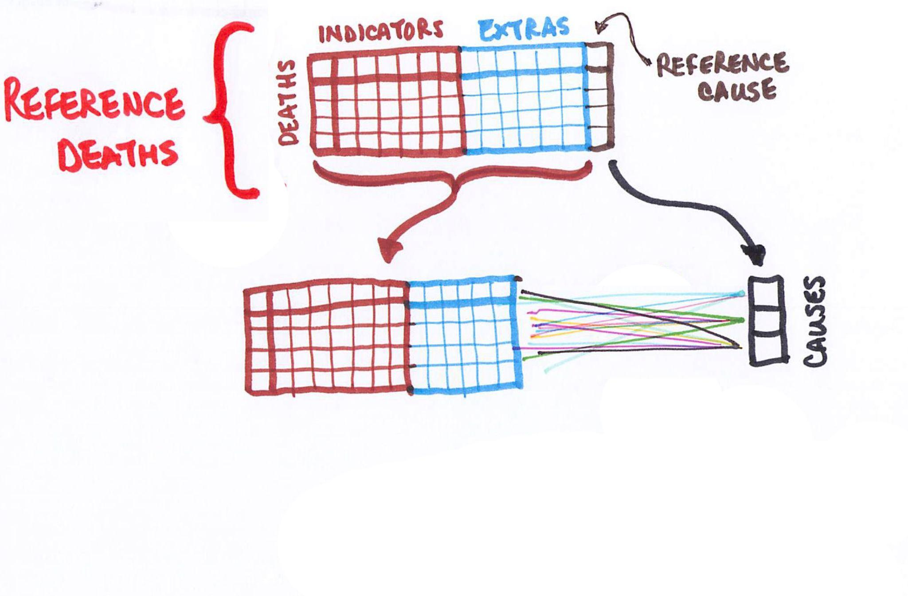
Reference death archive - RDA

Slide 18
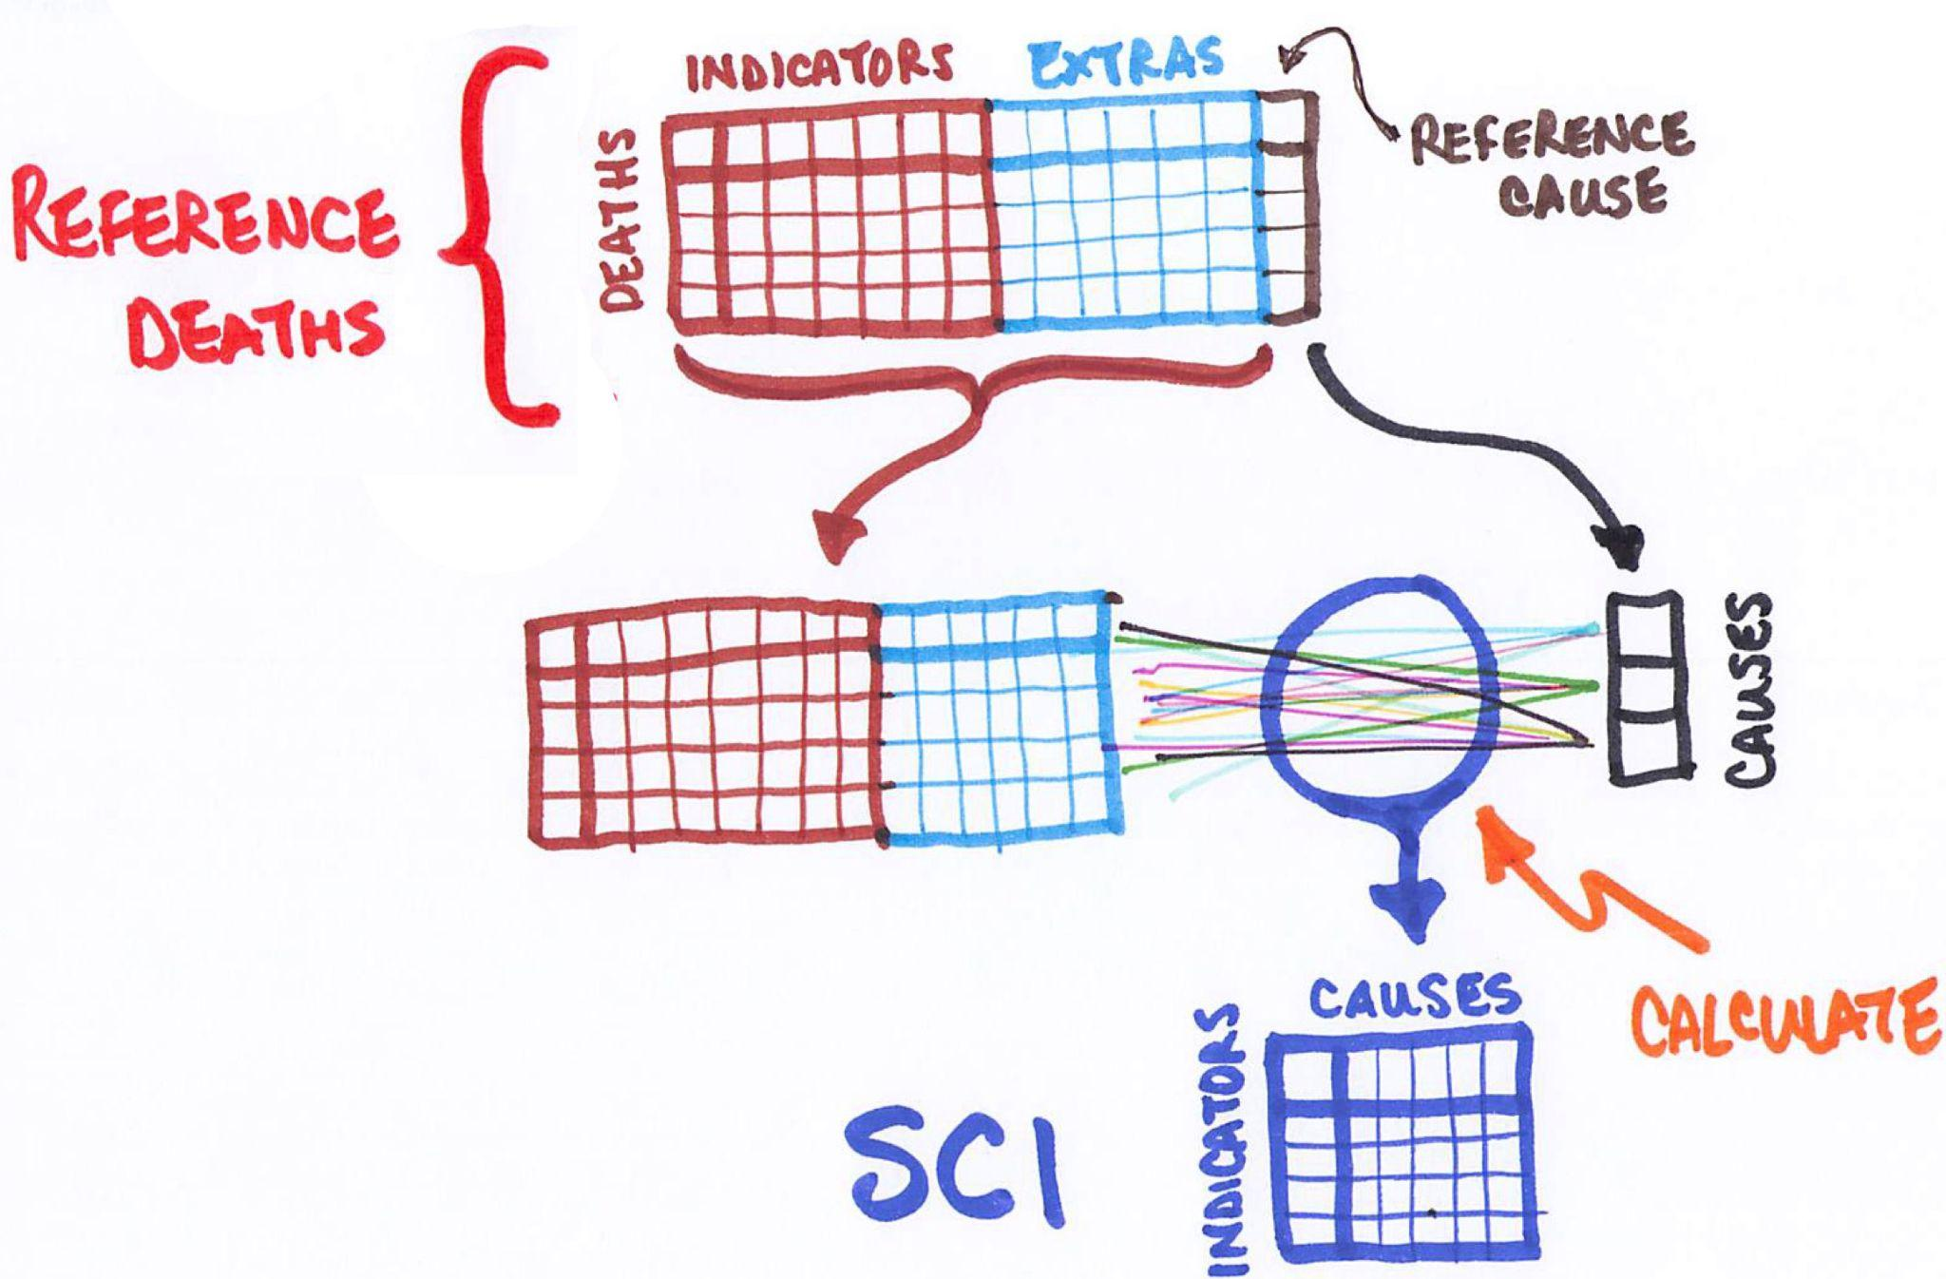
Reference death archive - RDA

Slide 19
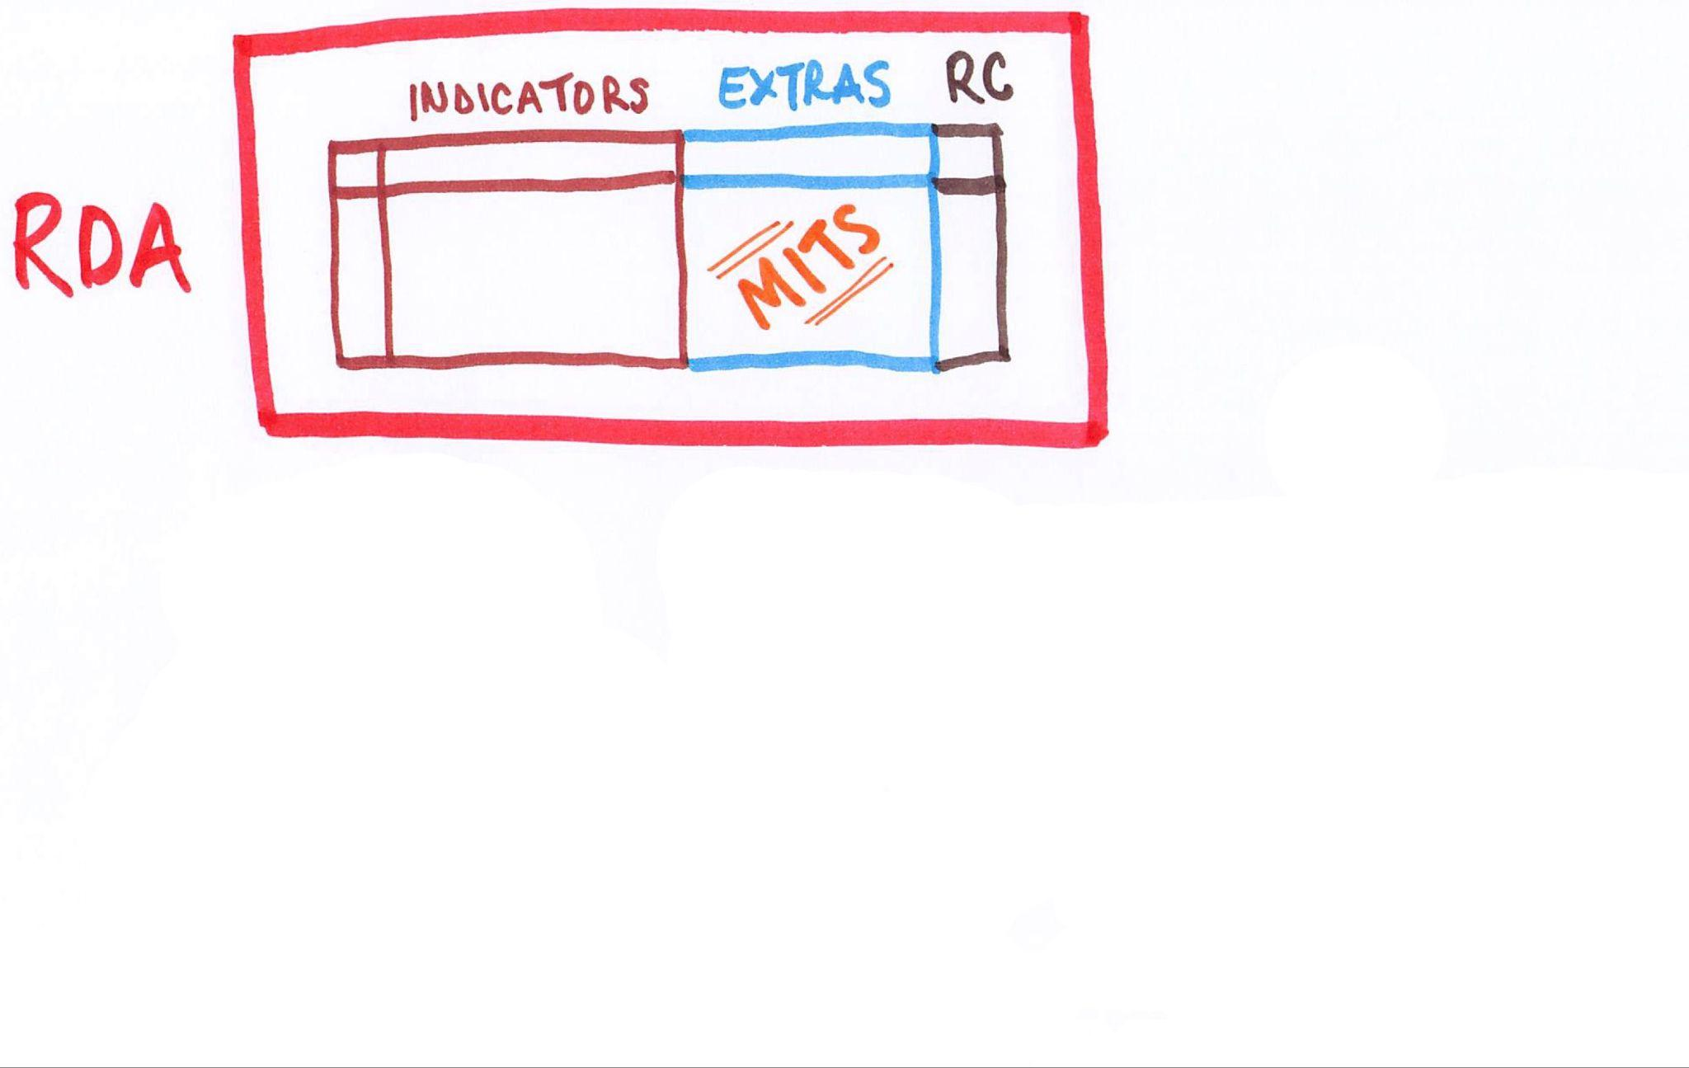
Operating the RDA

Slide 20
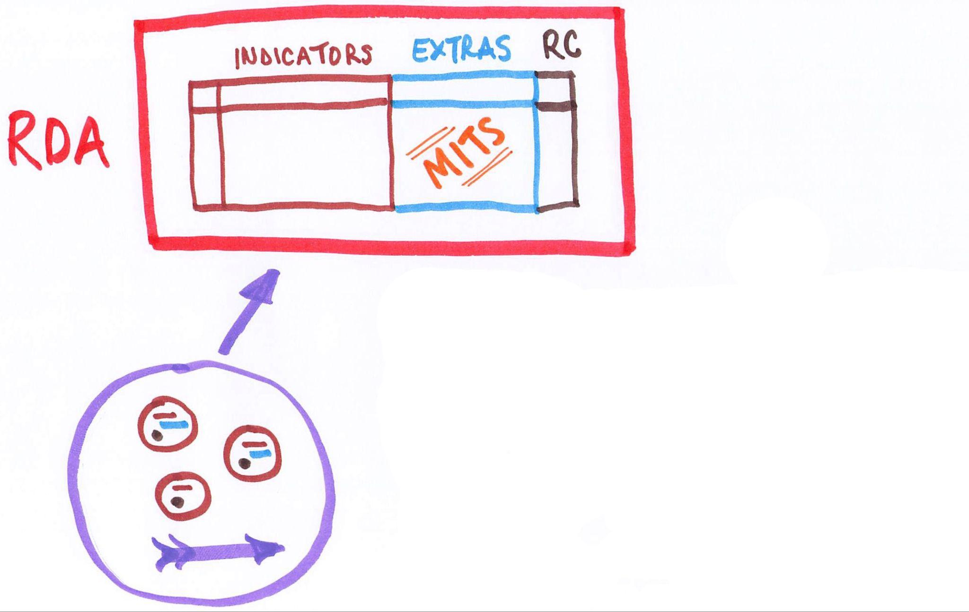
Operating the RDA

Slide 21
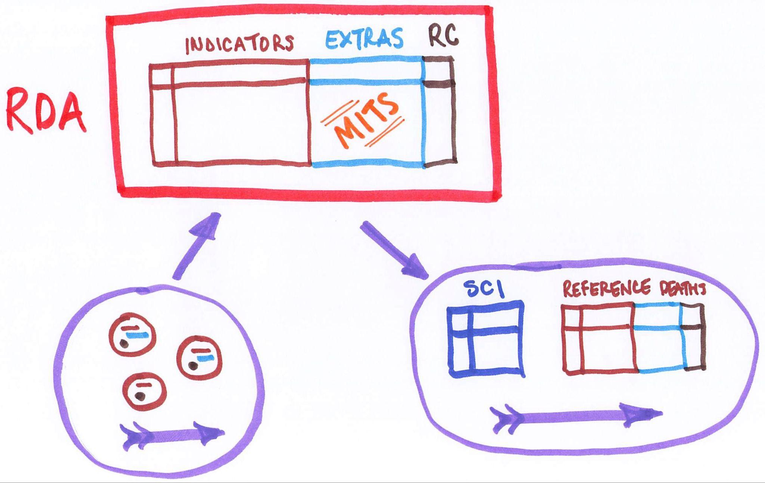
Operating the RDA

Slide 22
Progress building RDA
Database design - done
Schema
Data ingestion procedures/code
Data transformation (standardization) procedures/code
Pilot RDA with data from CHAMPS and COMSA - done
Discovered issues with data quality
Set up project with Sao Paulo mortality surveillance unit
Rapidly produce many reference deaths with MITS
Producing data by end of the year
Starting work with WHO to host RDA at WHO in Geneva
GUI interface, various outputs
Work on data use agreements, informed consent, and ethics ongoing

Slide 23
Expectations for MITS Alliance sites
MITS Alliance sites will be important, valuable contributors to RDA
WHO 2022 standard VA
MITS Alliance standard MITS
Informed consent that allows sharing through the RDA
Data use agreements that govern sharing
Site to MITS Alliance
MITS Alliance to RDA (or directly to RDA)
RDA to researchers and VA users in the future
Timeframe
RDA will be ready to take MITS Alliance data by end of 2023
Sites and MITS Alliance finalize DUAs by end of 2023
Share MITS Alliance site data with RDA as soon as sites are ready in 2024

Slide 24
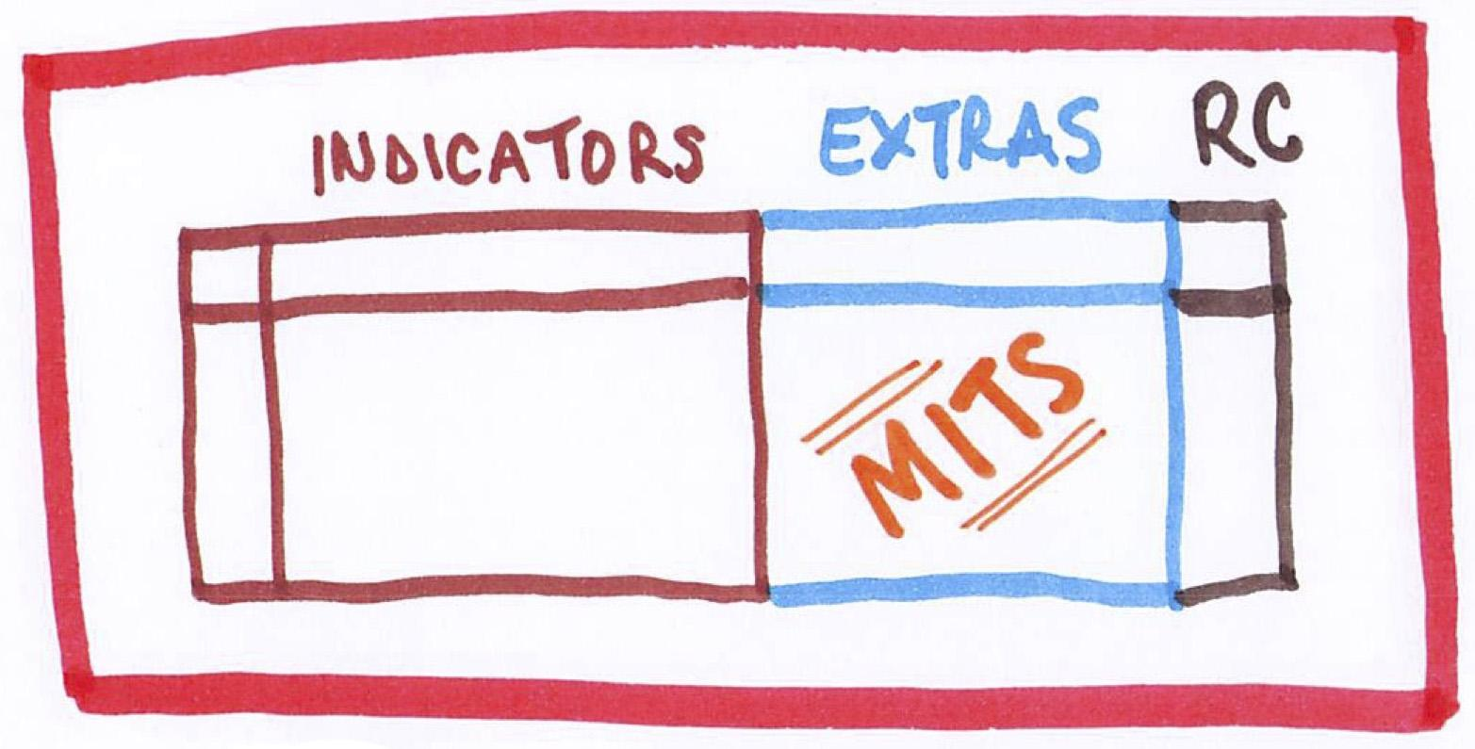
Questions

