Slide 1



Reference Data Archive RDA Launch
RDA Development Team
Samuel Clark
Kobus Herbst
Yue Chu
Brendan Gilbert
Dan-George Vasilache
Jason Thomas
Doris Ma Fat
Mona Sharon
David Plotner
Norman Goco
Philippe Boucher
Jean-Francois Saint-Pierre
Joven Larin

Slide 2
Outline: RDA
Motivation
What it is & how it works
Recorded demos
Operation modes
Planned launch data
Who operates the RDA

Slide 3
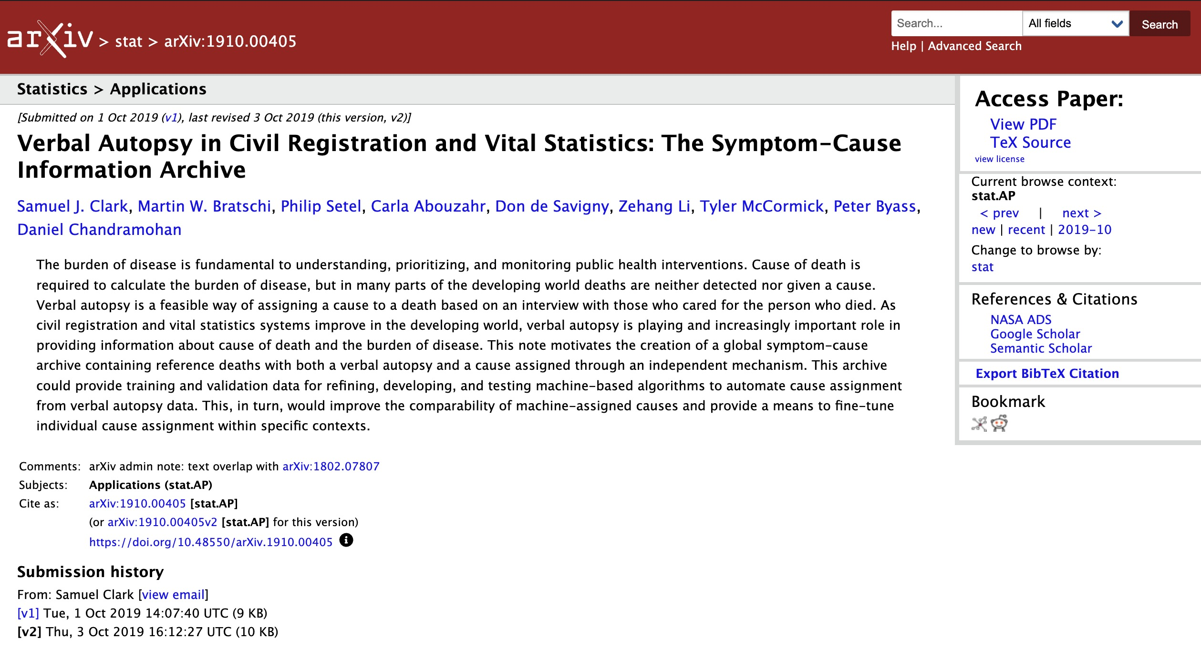

Slide 4
Motivation
Original motivation
Create a data resource to support research and methods development for verbal autopsy - reference deaths with cause
Trustworthy, high-visibility, third-party host: WHO
Enable wide array of researchers to rapidly make progress
Reference source for data supporting operation of verbal autopsy software
Analysis
Safe place to work on sensitive data
Clean, harmonized, documented data that are easy to work on
Modern tool set: R, Python, Julia

Slide 5
Motivation
Sharing
User-friendly portal for sharing results from analysis and/or data
Fully-documented data products
Searchable metadata catalog so you can easily find exactly what you want
Manage data use agreements and licenses
Access-controlled downloads
Evolved motivation
Not just verbal autopsy data, all kinds of (mostly) mortality data
Expand to provide these services for any kind of data

Slide 6
What it is
Resource at WHO - Data, Digital Health, Analytics and AI Department (DDA)
Data hosting and curating
Secure data analysis environment
Searchable, documented data repository
Tools for data sharing
Data collectors maintain ownership and control
Data collectors and/or analysts fully acknowledged and all data findable and citable with permanent digital object identifier: DOI

Slide 7
Data & analysis: trusted researcher environment (TRE)
Secure, access-controlled analysis environment
Vetted access
ORCID credentials
Contains clean, harmonized, documented, raw (sensitive) data
Provides R, Python, Julia in JupyterHub collaborative environment
Tools for accessing and manipulating data
Tools for preparing data products and/or data for sharing through data repository
VSCode and maybe RStudio later
Thinking through scaling up computation for ML/AI

Slide 8
Data discovery & sharing: repository (NADA)
Web portal for data exploration and access
Vetted data products with full documentation
Searchable catalog
Downloadable data, metadata, paradata, etc.
Date use agreements and/or licenses
Access control
ORCID credentials
WHO-linked DOI and full acknowledgement of data providers and/or analysts
"NADA" is an acronym for National Data Archive
NADA established to manage and catalog individual-level microdata from national statistical systems - i.e. big individual-level datasets
Created and maintained as open source resource by World Bank - widely used

Slide 9
How it works
Data provider signs Participation Agreement with WHO
Ownership and control of data remain with data provider – can be removed at any time
RDA Team curates data, provides analysis tools, and shares data products and/or data - consistent with terms of the Participation Agreement
Data ingested into RDA TRE
Evaluated
Cleaned
Harmonized as necessary
Fully documented
Optional with permission, data prepared for sharing and made available on repository

Slide 10
How it works
Vetted researchers able to access data within secure TRE
Conduct analysis
Prepare results for sharing
Submit results for sharing through the repository
RDA team evaluates results and/or data submitted for sharing
Ensure results do not contain non-sharable data
Ensure data are cleared to share
Post results and/or data to the repository for sharing to specified audience: only analysts, predetermined list of users, anyone with an ORCID, etc.
Results and/or data appear on repository for browsing and download
Each ‘dataset’ with DOI and full documentation, including names of data providers and/or analysts
Data use agreements/licenses enforced
‘Datasets’ available to specified audience(s) of users

Slide 11
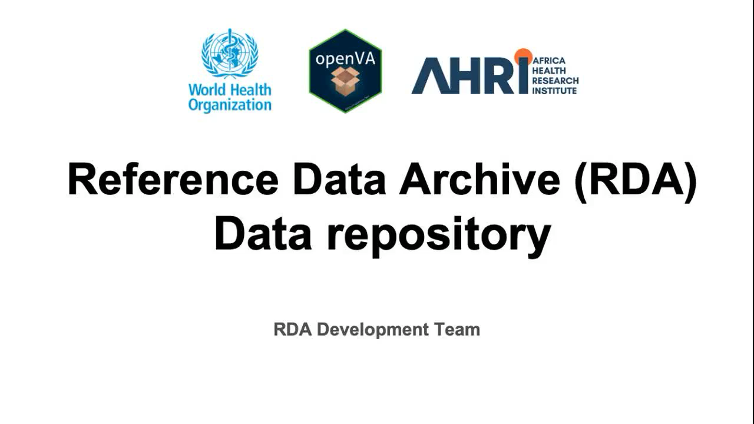

Slide 12
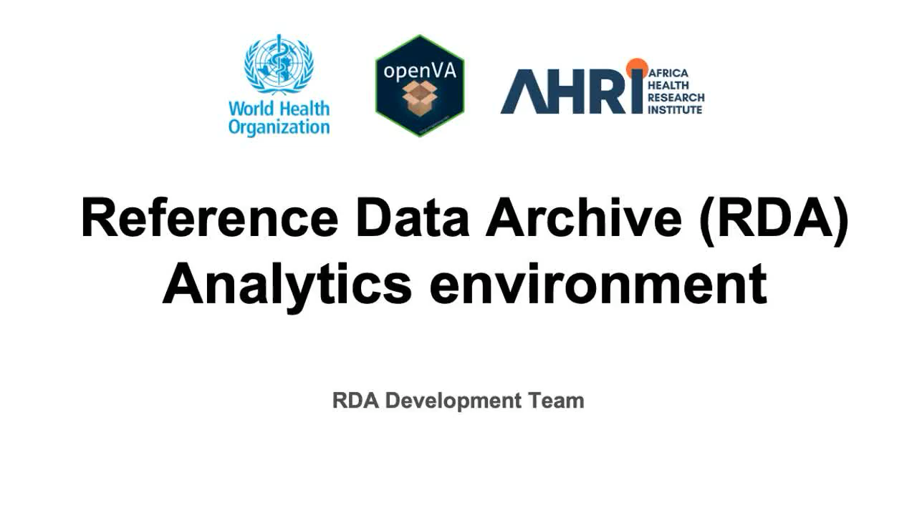

Slide 13
Default operation: highly secure with full access
Designed to host most sensitive data
Raw data stay safe in TRE and cannot leave
Data stay at WHO and never leave or live on computers outside of WHO
Only aggregated results with no individual-level data are shared through repository

Slide 14
Anything is possible - extremely flexible
With permission from data provider, can share anything
De-identified, individual-level data
Have fully tested this using CHAMPS & COMSA individual-level data - all data elements for each death available for download in a single, documented file
Anything else …
RDA funder (Gates) strongly encouraging launch data partners to share de-identified individual data in this way
The system - TRE & NADA - is not technically restricted in any way
RDA Team defines and enforces limits

Slide 15
Data at and shortly following launch
City of Sao Paulo Mortality Surveillance System / Department of Pathology, University of Sao Paulo, Brazil
Launch: ~2,500 deaths of all ages with older versions of VA and autopsy
1st quarter 2026: ~750 deaths of all ages with WHO 2022 VA, MITS, and autopsy
Future: ~1,500 deaths per year with WHO 2022 VA, autopsy, and most with MITS
CHAMPS, various sites/countries
~6,000 child deaths with various VA, MITS, and DeCode panel COD
COMSA Mozambique
~16,000 deaths of all ages with VA and various other information
HEAL-SL (COMSA) Sierra Leone
~12,000 deaths with VA and various other information

Slide 16
Who operates the RDA
RDA hosted and maintained at WHO Headquarters in Geneva
Computing machinery and network connections at WHO Headquarters in Geneva
IT security managed by WHO
WHO administrative responsibility in Data, Digital Health, Analytics and AI (DDA) Department - WHO RDA Co-Director is Doris Ma Fat
Philippe Boucher
George Vasilache
Haidong Wang
RDA Team includes members of the openVA Team led by Samuel Clark at The Ohio State University, USA - RDA Co-Director is Samuel Clark
Yue Chu
Jason Thomas
Additional RDA Team members
Kobus Herbst and Brendan Gilbert at the Africa Health Research Institute (AHRI), South Africa
David Plotner and Norman Goco at RTI

Slide 17
Launch: December 2025
https://data.who.int/rda
assistance-RDA@who.int
Slides: https://samclark.net/rda-slides
(select ‘Read Only’ when opening)
Samuel Clark: work@samclark.net
Doris Ma Fat: mafatd@who.int

